Slide 1
Qwaed Lost Assessment
WHY OPP ARE UNDER MOHD HAMDAN

Slide 2
Account Timeline
Account creation date: 15-AUG-17
15-AUG-17 - Mohammad Anas Karout (based on opp registered under him)
7-DEC-22 – Mohammad Hamdan
16-MAY-23 – Avinash Khot
31-MAY-23 – Mohammad Hamdan
23-JUN-23 – Hadi Mohamed Al Masri

Slide 3
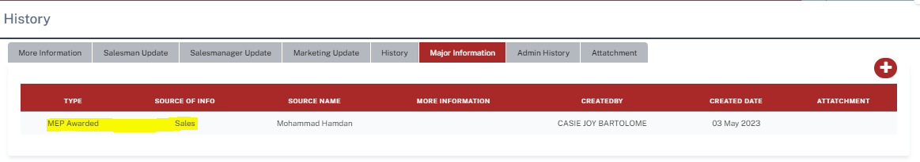
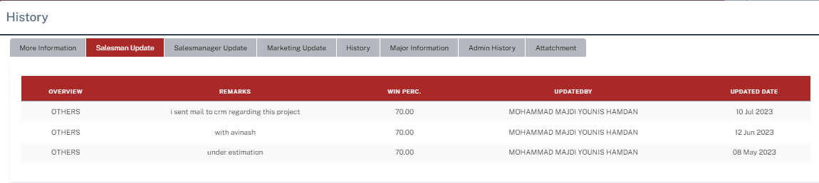
3-MAY-23 & 4-MAY-23 – Opp Created under Mohd Hamdan
Opp creation Date: 3-MAY-23 & 4-MAY-23
Source of Opp Creation: Sales
Source of Awarded: Sales

Slide 4
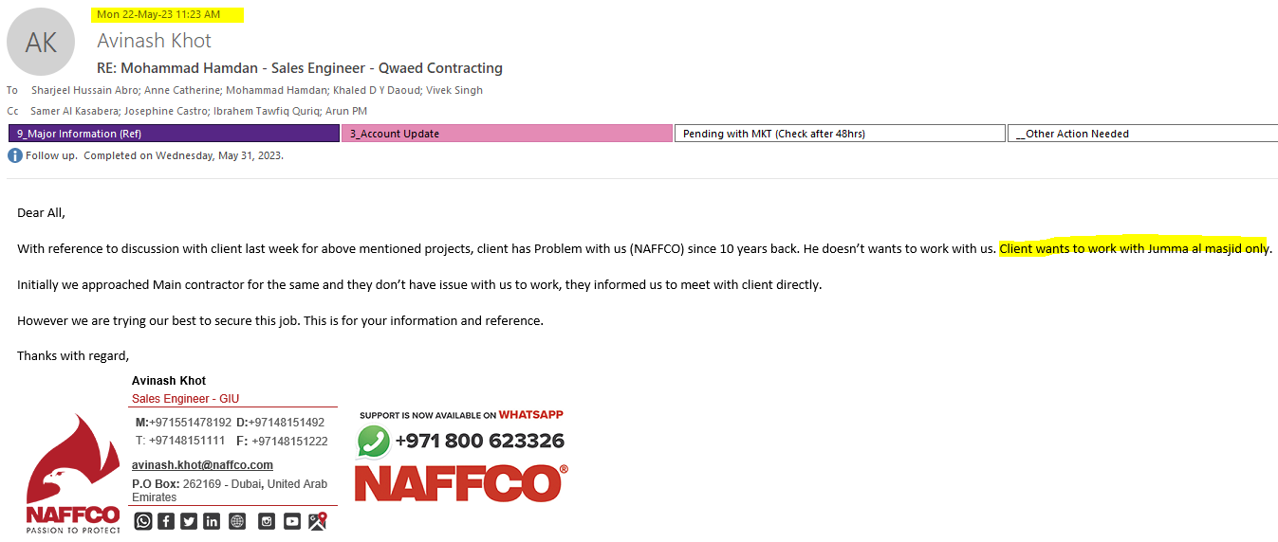
16-MAY-23 - Account Transferred from Mohd Hamdan TO Avinash Khot 22-MAY-23 – Takeover sales provided feedback about customer

Slide 5
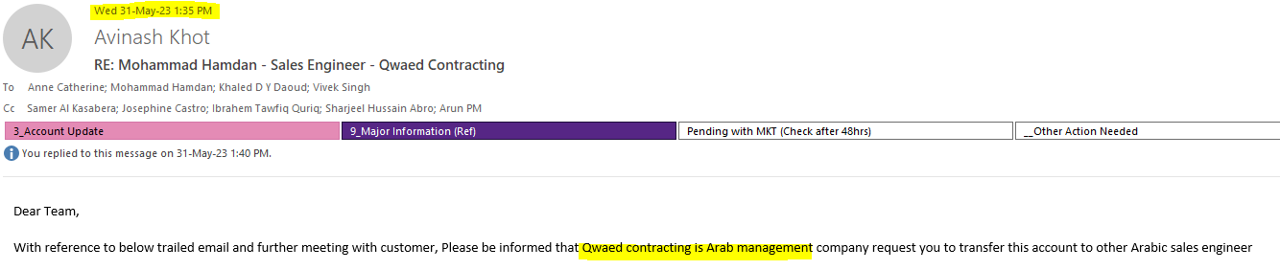
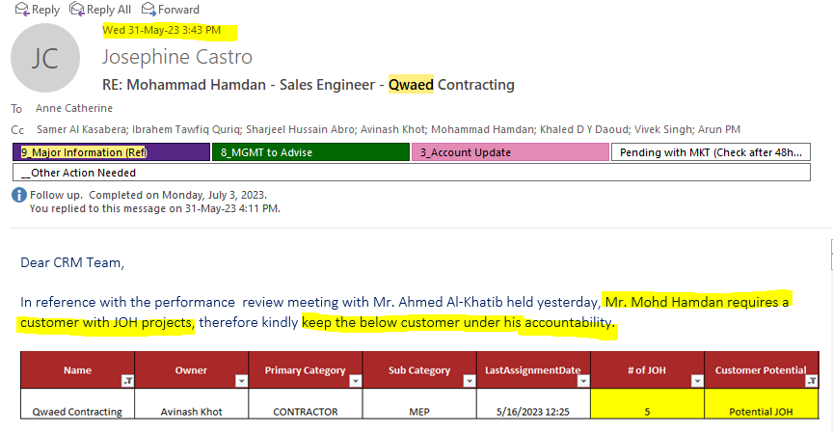
31-MAY-23 – Account reverted under Mohammad Hamdan as per MGMT

Slide 6
23-JUN-23 – Account Transferred to Hadi Mohamed Al Masri As per his remarks, 4 Opp reverted under Mohd Hamdan
Created Date | Project Number | Opportunity Number | Name | Client | Owner | Consultant | Marketing | Sales Stage | Status | Value | Qtn ref, | Sales Remarks (Hadi Al Masri)
03-May-23 | 1005230035 | 1023050029 | Prop Bldg (G+M) Res Units @ Zahya AJM On Plot No. 7752 |  | Mohammad Hamdan | Al Hilal Engineering Consultants (Ajman) | Husam Jawher | J.O.H | OPEN | 335,047.00 | 040478/01-23 | lost to firex ( hachtech) project value 70,000 AED
03-May-23 | 1005230040 | 1023050033 | Com Res Bldg (G+M) @ Zahya AJM On Plot No. 4740 |  | Hadi Mohamed Al Masri | Al Hilal Engineering Consultants (Ajman) | Husam Jawher | J.O.H | OPEN | 201,273.00 | 040482/02-23 | lost to lamasat project value 12,000 AED S+I
03-May-23 | 1005230041 | 1023050035 | Comm Res Bldg (G+M) @ Zahya AJM On Plot No. 4645 |  | Hadi Mohamed Al Masri | Al Hilal Engineering Consultants (Ajman) | Husam Jawher | J.O.H | OPEN | 196,631.00 | 040475/02-23 | lost to lamasat project value 12,000 AED S+I
04-May-23 | 1005230044 | 1023050038 | Prop Com Res Bldg (G+M) @ Zahya AJM On Plot No. 4742 |  | Hadi Mohamed Al Masri | Al Hilal Engineering Consultants (Ajman) | Husam Jawher | J.O.H | OPEN | 201,471.00 | 040535/02-23 | lost to lamasat project value 12,000 AED S+I

